Slide 1

ANALYZING RELATIONSHIP BETWEEN QB EPA BY ROUTE AND WIN%
Rocco Trinci
40129209
STAT 497

Slide 2
Presentation Summary
Overview of Football
Problem Statement
Relevant Information
Literature Review
Methodology
Dataset
Results
Conclusion
Limitations
Questions

Slide 3
American Football

Slide 6
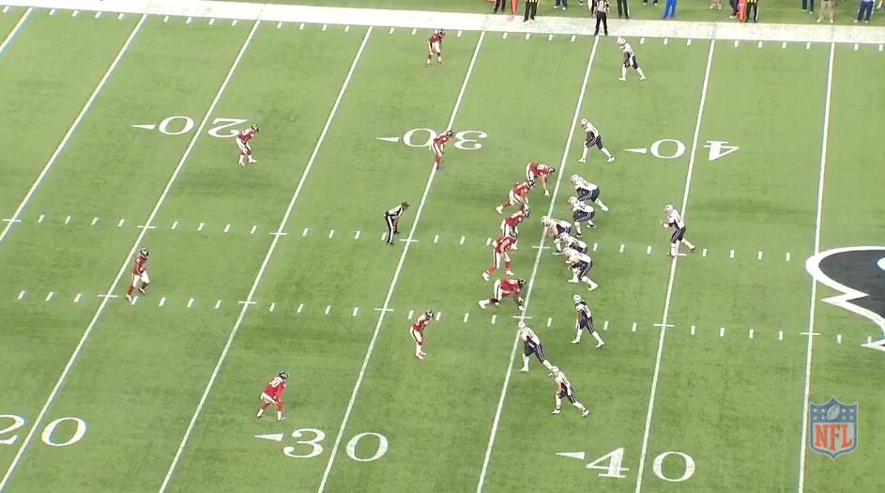
Quick Summary of American Football
Gameplay is broken up into what are referred to as ‘downs’
Each down begins with a ‘snap’, which involves center ‘hiking’ the ball back to the quarterback (QB)
The QB then tries to execute the predetermined offensive play with the goal of gaining the most possible yards
Conversely, the defensive team attempts to determine the play begin run and foil it

Slide 8
Does QB’s Total EPA On Certain Routes Better Predict Win%?

Slide 9
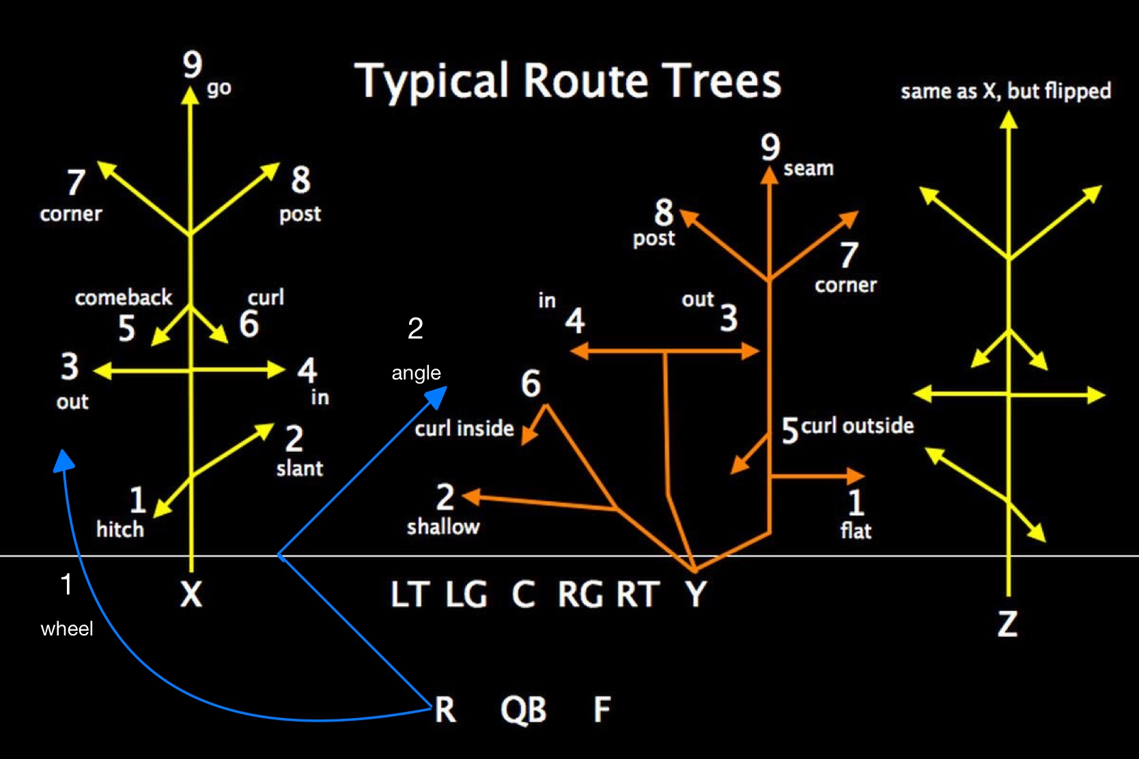
What is a Route?
“A route is a pattern or path that a receiver in gridiron football runs to get open for a forward pass.^{”1}
While any variations and subtleties, there exists a set group of route types that form the foundation for offensive play calling
¹ “Route (Gridiron Football),” Wikipedia (Wikimedia Foundation, September 23, 2022), https://en.wikipedia.org/wiki/Route_(gridiron_football).

Slide 10
Key Routes
Angle
Corner
Cross
Flat
Go
Hitch
In
Out
Post
Screen
Slant

Slide 11
What is EPA?
Stands for ‘Expected Points Added’
First introduced in 1970 by Virgil Carter & Robert E. Machol (Carter & Machol, 1971)
Aims to quantify the value gained/loss for every snap of a football game, taking into account game context
A team’s expected points at any point are calculated using “historical mathematical chances a team will score based on the field position and down’’ ¹
From there, EPA for each play can be calculated be taking the difference of a team’s EP before and after said play
In this study, will focus on EPA on passing plays (i.e. plays where a pass was completed, attempted or planned to be attempted but disrupted by the defense before the attempt), also known as PASS EPA
¹ Joey DiCresce et al., “Which QB Stats Are the Most Important?,” M, April 14, 2020, https://mfootballanalytics.com/2020/04/06/which-qb-stats-are-the-most-important/.

Slide 12
Literature Review
On a scholarly level, football lags behind in terms in-depth statistical analysis
However, similar to xG in football/soccer, the development and analysis of EPA models continue to rise
One of main uses of EPA and other holistic metrics is in the evaluation of player performance, specifically quarterbacks due to their large impact on games (Yurko et al. 2019, von Dohlen 2011)
Quarterback's total EPA, and to a higher degree total PASS EPA, have been shown to be the best predictors for Win% when it comes to individual quarterback metrics¹
In terms of player/team performance on different routes, very little work has been done on an academic level
¹ Joey DiCresce et al.

Slide 13
Methodology
The analysis conducted can be broken down into two parts:
Determining if there exists a significant statistical difference between the sample mean EPA produced per route
Done by conducting various one-way ANOVA tests
Determining if starting QB Total EPA on a certain combination routes better describes the variability of Win% of their respective team
Done by conducting several multiple Linear Regression between each starting quarterback’s Total EPA when targeting certain routes and their respective team’s season winning percentage

Slide 14
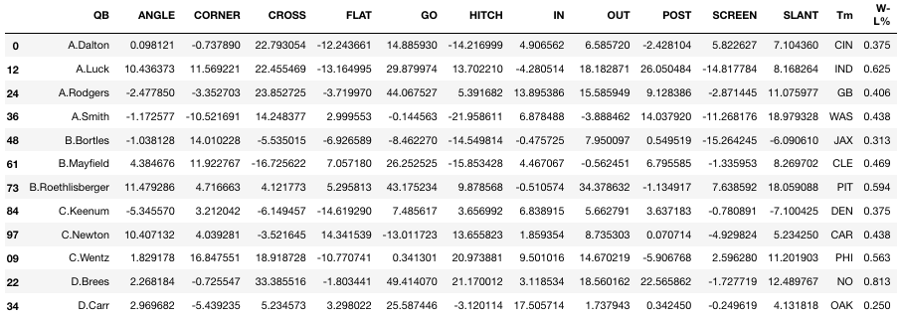
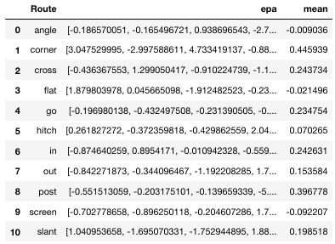
Dataset
NFL 2021 Big Bowl Dataset was used to conduct this analysis, along¹
Consists of play-by-play from the 2018-2019 NFL season
After some data cleaning and manipulation, the following datasets were created
¹ “NFL Big Data Bowl 2021,” Kaggle, accessed October 28, 2022, https://www.kaggle.com/competitions/nfl-bigdata-
bowl-2021/data?select=week1.csv.

Slide 15
Results

Slide 16
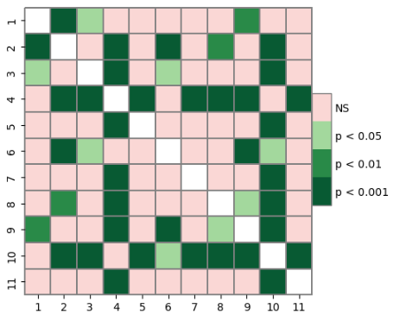
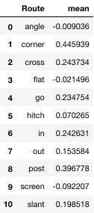
Sample Mean Comparison
When comparing the sample mean EPA produced per attempt for each route, a statistically significant difference was determined to exist between the sample means (p < 0.01)
While not the main focus, these results validates the idea of comparing EPA by route

Slide 17

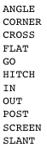
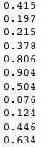
1st Multiple Regression
Several multiple linear regressions were conducted between the Total EPA produced by each starting QB on a given route and their team’s Win% for the season
The first model was conducted with every Total EPA per route vs. Win%
Results indicate that, combined, these variables account for 38.2% of the variability in a team’s Win%
However, the result of the model indicated that none of the variables correlated to the dependent variable

Slide 18
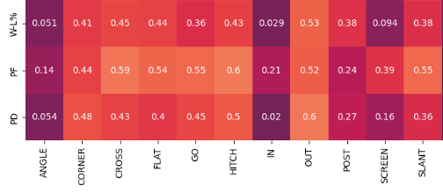







2nd Multiple Regression
To rectify this issue, a correlation matrix was produced to see which variables have the highest correlation to Win% on an individual level
The results indicate that Corner, Cross, Flat, Hitch and Out routes satisfy this need

Slide 19
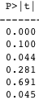
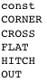
2nd Multiple Regression
As such, another multiple linear regression was conducted, this time only including the previous five routes
This model indicated that a much larger proportion of the variance in Win% was accounted for by these variables (42.3%)
Additionally, both Cross and Out routes were determined to have statistically significant correlation with the dependent variable
However, Corner and, to a larger degree, Flat and Hitch routes do not exhibit this correlation

Slide 20
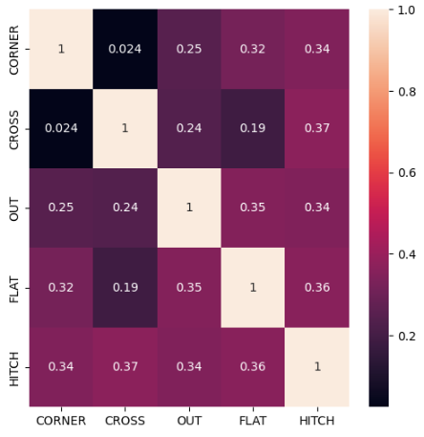
3rd Multiple Regression
Referring to the correlation matrix, it can be argued that correlation exists between Flat/Hitch and the other remaining independent variables (i.e. multicollinearity)

Slide 21
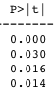
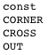
3rd Multiple Regression
Armed with this info, a multiple linear regression model was created between the Corner, Cross and Out variables and Win%
The results is a model for which the independent variables account for the largest amount of variability in Win% (43.1%) amongst the three models
Additionally, unlike the previous two models, all the independent variables included significantly correlate to Win%

Slide 22
Summary of Results
Independent Variables | Dependent Variable | % of Variability Accounted For | Significant Ind. Variables
Angle, Corner, Cross, Flat, Go, Hitch, In, Out, Post, Screen, Slant (i.e. All Routes) | Team Win% | 38.2% | None
Corner, Cross, Flat, Hitch, Out, | Team Win% | 42.3% | Cross, Out
Corner, Cross, Out, | Team Win% | 43.1% | Cross, Corner, Out (i.e. All Ind. Var.)

Slide 23
Conclusion
When accounting for the total EP a QB adds when targeting a given route, the routes that best describe the variability of the QB’s Win% in a significant manner are Corner, Cross and Out routes
Thus, can conclude that EP gained from certain routes is in fact more valuable than EP gained from others
This trio of routes accounts for every level of the field, as well as both inside and outside directions
These facts add circumstantially evidence to the results since it demonstrates how they do not favor any specific type of route
Additionally, the variety in the route type allows for potentially actionable decisions (i.e. favour crossing routes over slants, outs over comebacks, etc..)

Slide 24
Limitations
Lack of multiple seasons of data leaves open the possibility that the results obtained are skewed due to season-to-season biases
Within the given data, a lack of the full count of routes targeted on the season may also have resulted in conclusions that do not fully represent the actual context of the season
These issues can be solved by obtaining more various and accurate data
Potential combination with route recognition tools may be one way of improving the data

Slide 25
Questions

Slide 26
Works Cited
Carter, Virgil, and Robert E. Machol. “Technical Note—Operations Research on Football.” Operations Research 19, no. 2 (1971): 541–44. https://doi.org/10.1287/opre.19.2.541.
Yurko, Ronald, Ventura, Samuel and Horowitz, Maksim. "nflWAR: a reproducible method for offensive player evaluation in football" Journal of Quantitative Analysis in Sports 15, no. 3 (2019): 163-183. https://doi.org/10.1515/jqas-2018-0010
von Dohlen, Paul. “Tweaking the NFL's Quarterback Passer Rating for Better Results.” Journal of Quantitative Analysis in Sports 7, no. 3 (2011). https://doi.org/10.2202/1559-0410.1359.

